Slide 1
Image Analysis

Slide 2
Frequency Domain Filtering

Slide 3
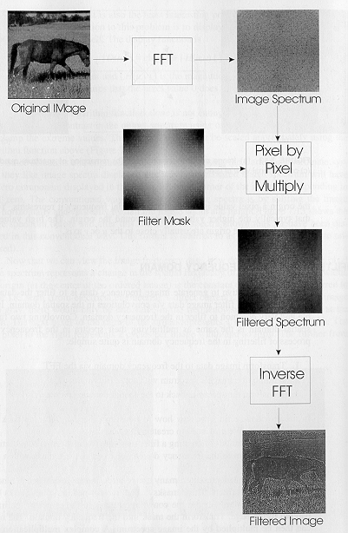

Frequency Domain Methods
F(u,v)
f(x,y)
complex multiplication
Very important:
the centers of
F(u,v) and H(u,v) must
coincide!
H(u,v)
Case 1: H(u,v) is specified directly in the frequency domain.
Case 2: H(u,v) is specified indirectly in the frequency domain by specifying h(x,y) in the spatial domain.
G(u,v)
g(x,y)

Slide 4
Frequency domain filtering: Case 1
Given an input image f(x,y) of size M x N, set the padding sizes P and Q, e.g., P=2M and Q=2N
(note: P and Q must also be a power of 2 to use FFT)
2. Form a padded image f_{p}(x,y) of size P x Q
3. Multiply f_{p}(x,y) by (-1)^{x+y} to center its spectrum.
4. Compute the DFT, F(u,v), of the image from Step 3.
F(u,v) = R(u,v) + jI(u,v)

Slide 5
Frequency domain filtering: Case 1 (cont’d)
5. Create H(u,v) of size P x Q with center at (P/2, Q/2). This is typically done by specifying and sampling the desired filter function.
Example:
6. Compute the product G(u,v)=H(u,v)F(u,v) using elementwise “complex” multiplication. If H(u,v) is real, this is:
Butterworth lowpass filter
G(u,v)= F(u,v)H(u,v) = H(u,v) R(u,v) + jH(u,v)I(u,v)
where u=0,1,...,P-1, v=0,1,…,Q-1
where
F(u,v) = R(u,v) + jI(u,v)

Slide 6
Frequency domain filtering: Case 1 (cont’d)
7. Obtain the filtered image g_{p}(x,y) by computing the inverse DFT of G(u,v):
8. Obtain the final filtered result, g(x,y), of size M x N, by extracting the
M x N region from the top, left quadrant of g_{p}(x,y) (i.e., “undo” padding).
explicitly disregard the
imaginary part
“undo” the centering
transformation

Slide 7
Example
f(x,y)
f_{p}(x,y)
f_{p}(x,y)(-1)^{x+y}
F(u,v)
H(u,v) – centered
(Gaussian)
G(u,v)=F(u,v)H(u,v)
g_{p}(x,y)
g(x,y)

Slide 8
Frequency domain filtering: Case 2
Given an input image f(x,y) of size M x N, and a filter h(x,y) of size K x L,
set the padding sizes P and Q, e.g., P=M+K-1 and Q=N+L-1 (note: P and Q must also be a power of 2 to use FFT).
2. Generate H(u,v) as described next.
3. The rest of the steps are the same as before.

Slide 9
Specify h(x,y) in the spatial domain (Case 2)
When specifying h(x,y) in the spatial domain, H(u,v) can be generated as follows:
Form h_{p}(x,y) by padding h(x,y) with zeroes.
2. Multiply h_{p}(x,y) by (-1)^{x+y} to center its spectrum.
3. Compute its DFT to obtain H(u,v).
*
*
The symmetry of h(x,y) must be explicitly preserved when padding with 0s; let’s see why!
Notes:
9

Slide 10
Example: specify h(x,y) in the spatial domain
f(x,y)
F(u,v)
Result of spatial
domain filtering:
Result of frequency
domain filtering:
600 x 600
g(x,y)=f(x,y)*h(x,y)
g(x,y)=F⁻¹{G(u,v)=F(u,v)H(u,v)}
602 x 602
h(x,y)
H(u,v)
spatial
3 x 3
Sobel
602 x 602
frequency
P=Q=600+3-1=602
f_{p}(x,y) and h_{p}(x,y) will be 602 x 602
Notes:
10
In this example, we start with a spatial mask and show how to generate its corresponding filter in the frequency domain. Then, we compare the filtering results obtained using frequency domain and spatial techniques. We use the 3x3 Sobel vertical edge detector. The left one is a 600x600 pixel image, and its spectrum is shown on the right.

Slide 11
Major filter categories
Filters are classified based on their properties in the frequency domain:
(1) Low-pass
(2) High-pass
(3) Band-pass
(4) Band-stop

Slide 12
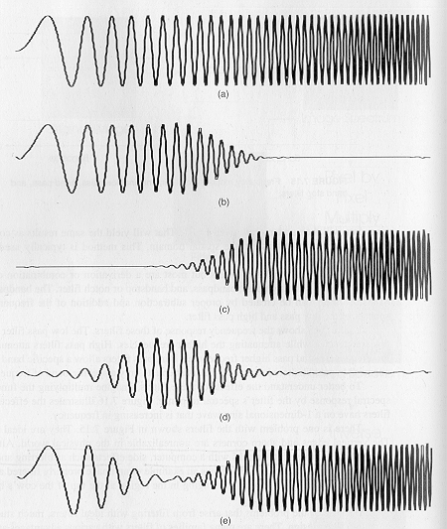
Example
Original signal
Low-pass filtered
High-pass filtered
Band-pass filtered
Band-stop filtered

Slide 13
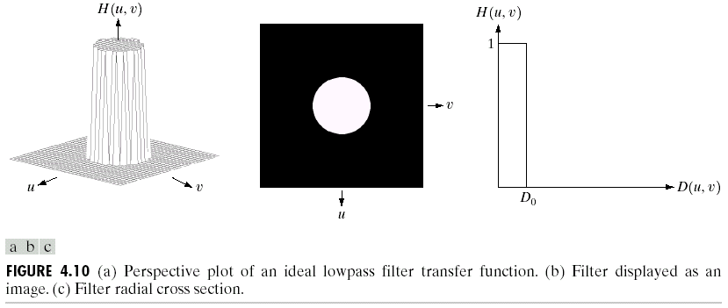
Ideal Lowpass Filter
Ideal LPF Filter Transfer function
where D(u,v) = Distance from (u,v) to the center of the mask.
(Images from Rafael C. Gonzalez and Richard E.
Wood, Digital Image Processing, 2nd Edition.

Slide 14
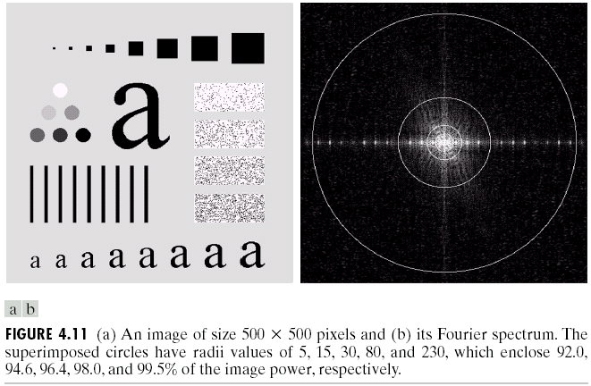
Examples of Ideal Lowpass Filters
(Images from Rafael C. Gonzalez and Richard E.
Wood, Digital Image Processing, 2nd Edition.
The smaller D₀, the more high frequency components are removed.

Slide 15
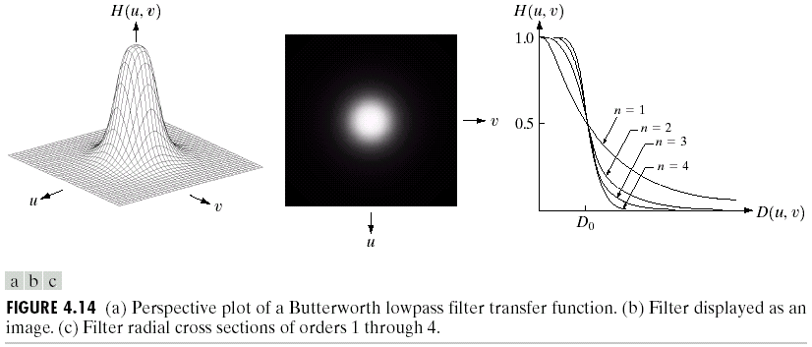
Butterworth Lowpass Filter
Transfer function
Where D₀ = Cut off frequency, N = filter order.
(Images from Rafael C. Gonzalez and Richard E.
Wood, Digital Image Processing, 2nd Edition.

Slide 16
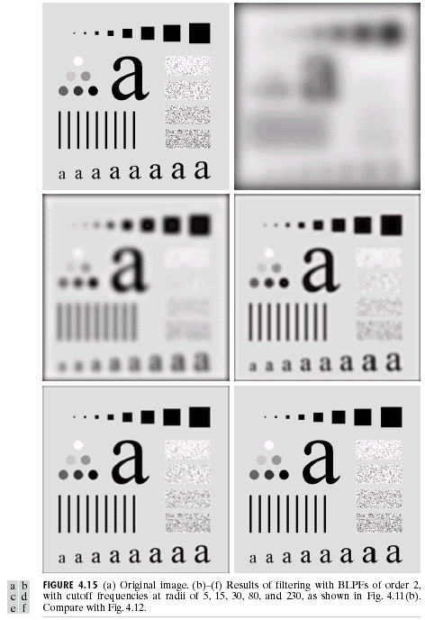
Results of Butterworth Lowpass Filters
There is less ringing
effect compared to
those of ideal lowpass
filters!
(Images from Rafael C. Gonzalez and Richard E.
Wood, Digital Image Processing, 2nd Edition.

Slide 17
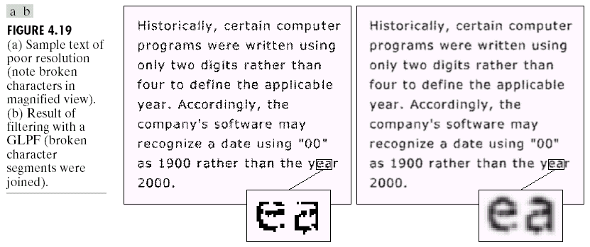
Application of Gaussian Lowpass Filters
Original image
Better Looking
The GLPF can be used to remove jagged edges and “repair” broken characters.
(Images from Rafael C. Gonzalez and Richard E.
Wood, Digital Image Processing, 2nd Edition.

Slide 18
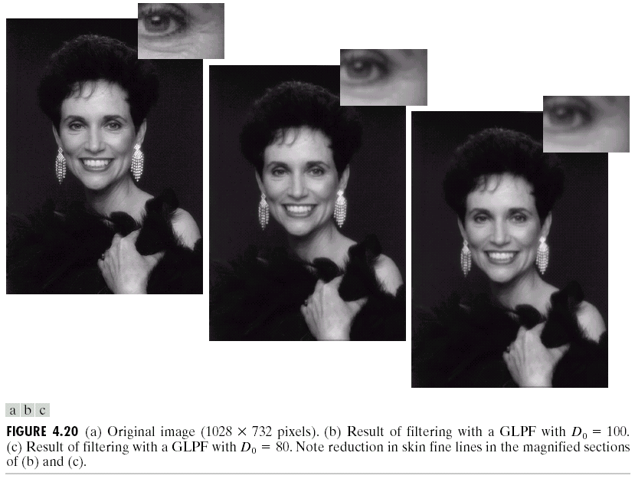
Application of Gaussian Lowpass Filters (cont.)
Remove wrinkles
Original image
Softer-Looking
(Images from Rafael C. Gonzalez and Richard E.
Wood, Digital Image Processing, 2nd Edition.

Slide 19
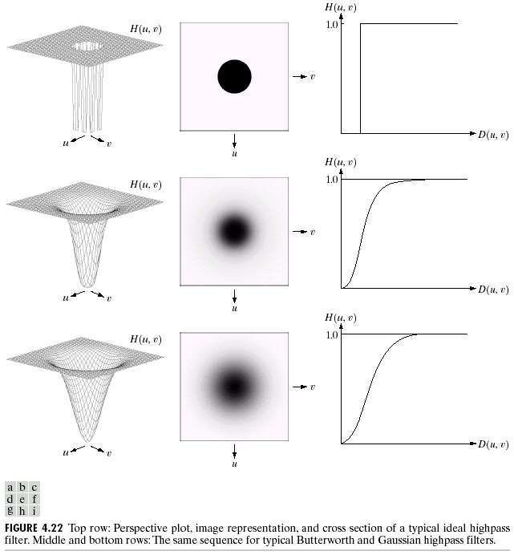
Highpass Filters
H_{hp} = 1 - H_{lp}
(Images from Rafael C. Gonzalez and Richard E.
Wood, Digital Image Processing, 2nd Edition.

Slide 20
Ideal Highpass Filters
Ideal LPF Filter Transfer function
where D(u,v) = Distance from (u,v) to the center of the mask.
(Images from Rafael C. Gonzalez and Richard E.
Wood, Digital Image Processing, 2nd Edition.

Slide 21
Gaussian Highpass Filters
Transfer function
Where D₀ = spread factor.
(Images from Rafael C. Gonzalez and Richard E.
Wood, Digital Image Processing, 2nd Edition.

Slide 22
Sharpening Filtering in the Frequency Domain
Spatial Domain
Frequency Domain Filter
(Images from Rafael C. Gonzalez and Richard E.
Wood, Digital Image Processing, 2nd Edition.

Slide 23
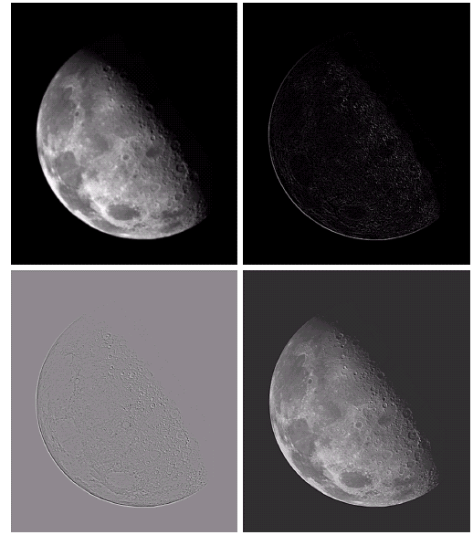
Sharpening Filtering in the Frequency Domain (cont.)
p
(Images from Rafael C. Gonzalez and Richard E.
Wood, Digital Image Processing, 2nd Edition.

Slide 24
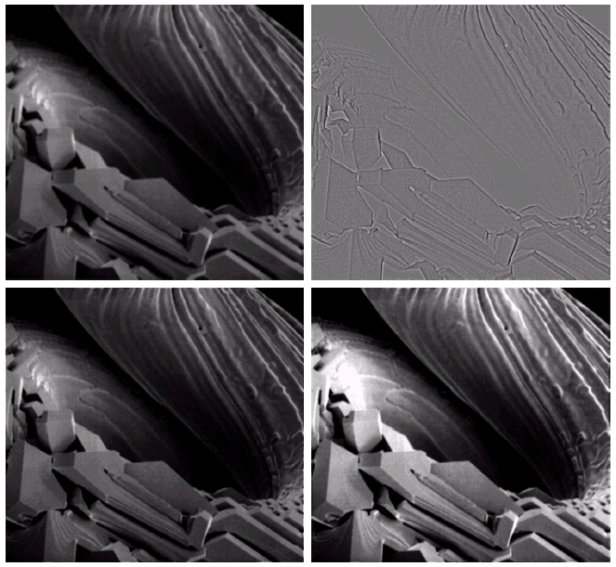
Sharpening Filtering in the Frequency Domain (cont.)
f
A = 2
A = 2.7
(Images from Rafael C. Gonzalez and Richard E.
Wood, Digital Image Processing, 2nd Edition.

Slide 25
Point processing
Simple gray level transformations
Image negatives
Log transformations
Power-law transformations
Contrast stretching
Gray-level slicing
Bit-plane slicing
Histogram processing
Histogram equalization
*Histogram matching (specification)
Arithmetic/logic operations
Image averaging
Mask processing (spatial filters)
Smoothing filters (blur details)
Average, weighted average
Order statistics (e.g. median)
Sharpening filters (highlight details)
Unsharp masking
High-boost filters
Derivative filters
The Laplacian
The Gradient
Frequency domain filters
Smoothing filters (blur details)
Ideal lowpass filter
Butterworth lowpass
Gaussian lowpass
Sharpening filters (highlight details)
Unsharp masking
High-boost filters
Derivative filters - The Laplacian
Ideal highpass filter
Butterworth highpass filter
Gaussian highpass filter
Homomorphic filtering

